Slide 1
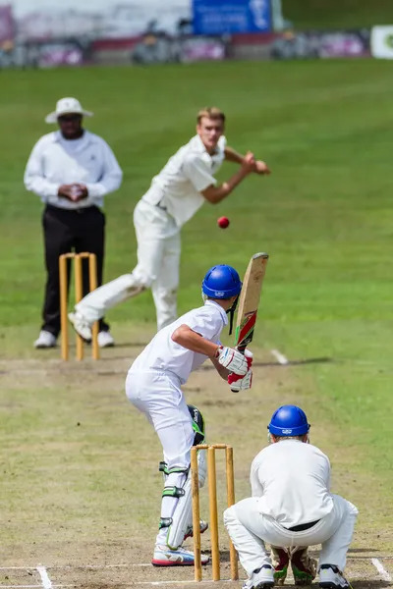
Cricket: The Game of Bat
An Informative Presentation
Author: Amey G M
Date: October 26, 2023
A Deep Dive into the Dynamics of Cricket

Slide 2
The Basics of Cricket
Batting: The primary offensive role, aiming to score runs by hitting the ball bowled by the opposing team. Different shots are employed depending on the ball's trajectory and the batsman's strategy.
Bowling: The defensive role, aiming to dismiss batsmen by getting the ball to hit the wickets or through other means like catches. Different bowling styles exist, each with its own strengths and weaknesses.
Fielding: Involves strategically positioning players on the field to prevent runs and dismiss batsmen. Fielding requires agility, quick reflexes, and accurate throws.
Scoring: Runs are scored by hitting the ball and running between the wickets, hitting boundaries (fours and sixes), and through extras conceded by the bowling team.

Slide 3
Key Strategies and Tactics
Batting Strategies: Vary depending on the match situation (e.g., aggressive batting in the early stages, cautious batting in the later stages). Partnerships between batsmen are crucial for building a strong score.
Bowling Strategies: Involve varying pace, spin, and line/length to outsmart batsmen. Field placements are adjusted to support the bowler's strategy.
Fielding Strategies: Positioning fielders based on the batsman's strengths and weaknesses, the type of bowling, and the match situation. Quick thinking and precise execution are vital.
Teamwork: Cricket is a team sport; success relies on effective communication and coordination between batsmen, bowlers, and fielders.

Slide 4
Evolution of the Game
Early Forms: Cricket's origins are debated, but it evolved from children's games in medieval England. Early forms were simpler, with fewer rules and less structured play.
Formalization of Rules: Over centuries, the rules became standardized, leading to the formation of clubs and competitions. The game gradually gained popularity.
International Cricket: The establishment of international cricket boards and the introduction of Test matches, One Day Internationals (ODIs), and Twenty20 (T20) formats marked significant milestones.
Modern Cricket: The game continues to evolve, with innovations in equipment, strategies, and media coverage. The global popularity of cricket continues to grow.

Slide 5
Summary / Key Takeaways
Summary Points:
Cricket involves batting, bowling, and fielding, with the objective of scoring more runs than the opponent.
Successful cricket requires strategic planning and effective teamwork.
The game has evolved significantly over centuries, from simple beginnings to a globally popular sport.
Different formats of cricket (Test, ODI, T20) cater to diverse preferences and playing styles.
Understanding the basics and strategies is key to appreciating the complexities and excitement of cricket.

Slide 6
Timeline of Cricket's Evolution
16th Century:
Early forms of cricket emerge in England.
18th Century:
The game gains popularity, with the formation of clubs and the development of basic rules.
19th Century:
Cricket becomes increasingly organized, with the establishment of county cricket and international matches.
20th Century:
Test cricket becomes the dominant format, followed by the introduction of ODIs.
21st Century:
The rise of T20 cricket revolutionizes the game, making it faster and more accessible to a wider audience.

Slide 7
Thank You
We appreciate your time and attention

